Slide 1
Early Identification of Pulmonary Embolism In Intensive Care Unit
Members: Tim, Daisy, Peng, Yan

Slide 2
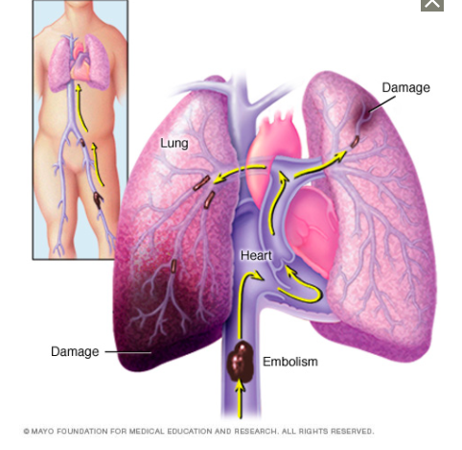
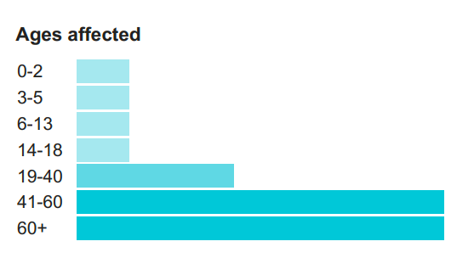
Introduction
Pulmonary Embolism is a blockage in one of the pulmonary arteries in the lungs. In most cases, pulmonary embolism is caused by blood clots that travel to the lungs from the legs or, rarely, other parts of the body (deep vein thrombosis).
Usual onset: Older people
Risk factors: Cancer, prolonged bed rest, smoking, stroke, estrogen-based medication, pregnancy, obesity, after surgery

Slide 3
Introduction
Symptoms: non-specific
Shortness of breath,
Chest pain,
Cough
Diagnostic method: Based on symptoms, D-dimer, CT pulmonary angiography, lung ventilation/perfusion scan
Morbidity: In the United States between 300,000 and 600,000 cases occur each year, which results in between 50,000 and 200,000 deaths.
Complications:
Passing out,
abnormally low blood pressure,
sudden death

Slide 4
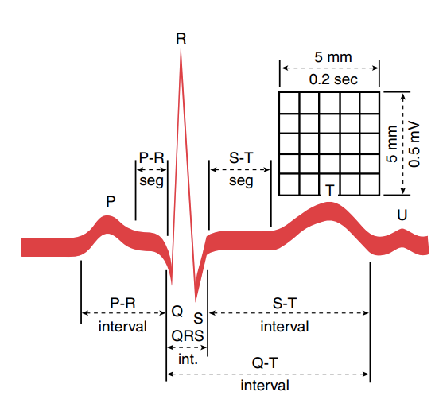
Objectives
To assist the PE diagnosis by existing less invasive and low-cost tests in ICU
Methods
Dataset: MIMIC-III (intensive care units of Beth Israel Deaconess Medical Center)
Attributes:
Patient Characteristics: Age, Gender, Race
Clinical lab tests
Electrocardiography(ECG): Recording the electrical activity of the heart
(Height: voltage(mv); Width: duration(ms); 12 leads)
Lead II. QRS complex waveform.
Data processing:
Contrast mining, Deep learning
Notes:
4

Slide 5
Dataset
Data collected from Beth Israel Deaconess Medical Center critical care units between 2001 and 2012.
Includes over 40,000 patients
MIMIC-III Clinical dataset
MIMIC-III Waveform Database Matched subset – matched with 10,282 MIMIC-III clinical records

Slide 6
Preprocessing
58976 visits and 46520 patients in total
1109 visits and 1061 PE patients in total
350 visits and 329 PE patients left after matched EKG waveform
Control group has the same demographic distribution

Slide 7
Infer diagnosed time
D-dimer
Blood gas/ White Blood Cell Count/ Erythrocyte Sedimentation Rate/ Lactate dehydrogenase Test/ Creatine phosphokinase Test/ Aspartate Aminotransferase/ Fibrin Degradation Products
118 visits diagnosed as PE primarily
48 PE visits took D-dimer test
Heparin (26)
Warfarin (17)

Slide 8
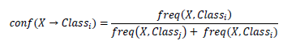
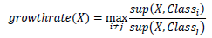
Contrast Set Mining
Contrast set Mining is a form of ARM to identify different patterns between separate groups.
Transactions: D={t1,t2, …, tn}
Support of an itemset is percentage of transactions which contain that itemset
Confidence is the conditional probability of a Class given a certain pattern
Growth rate is represented as the ratio between supports. This measure is preferred for rare item sets

Slide 9
CSM-Example
PE Patients Non-PE Patients
Support (WBC, LDH) = 0.5 Support (LDH, WBC) = 0.25
Growth (High Risk => Diabetes, Hypertension) =2
Patients | Lab Tests
P1 | D-Dimer
P2 | D-Dimer, WBC
P3 | WBC, LDH, D-Dimer
P4 | WBC, LDH
Patients | Lab Tests
P1 | FDP
P2 | LDH, WBC
P3 | AST
P4 | AST, LDH

Slide 10
Experiment design
Data selection
Study and Control group have the same demographic distribution
350 transactions for each group
All abnormal lab tests
Contrast Set Mining
Statistical test

Slide 11
Results
Contrast Patterns | Support | Growth | P value
olderthan60,Blood Gas, Sedimentation Rate | 0.0314 | 3.666667 | 2.845584e-79
F, White Blood Cell, D-Dimer | 0.0429 | 2.142857 | 2.954538e-06
lessthan40, Blood Gas, F | 0.0314 | 2.4 | 1.547295e-16
SINGLE,F, Sedimentation Rate | 0.0429 | 7 | 0.415587
Sedimentation Rate, Blood Gas | 0.0314 | 2.1 | 0.000522439
Sedimentation Rate, White Blood Cell, Blood Gas | 0.0429 | 2.111111 | 1.726349e-07
Sedimentation Rate, MARRIED,M | 0.0314 | 3 | 0.1443917
olderthan60, Sedimentation Rate, M | 0.0429 | 2.25 | 1.026066e-78
lessthan60, Sedimentation Rate, M | 0.0314 | 2.333333 | 4.008446e-36
M,HISPANIC OR LATINO, White Blood Cell | 0.0429 | 3 | 7.806275e-06
Blood Gas, White Blood Cell, DIVORCED | 0.0314 | 2.6 | 1.975742e-07
Blood Gas, White Blood Cell,lessthan40 | 0.0429 | 2.142857 | 5.38918e-20
Sedimentation Rate, Blood Gas, F | 0.0314 | 4 | 0.001633929

Slide 12
Results
16 unique items
3 Age
2 Sex
1 Mortality Status
4 Marital Status
2 Race
4 Lab Tests (Blood Gas, Sedimentation Rate, White Blood Cell, D-Dimer)
17 out of 19 rules are significant.

Slide 13
Interpretation-Clinical Attributes
Lab test: Blood test
Blood Gas: PaO2 < 80mmHg-draw from artery
WBC: 10~15 x 10⁹
ESR(Erythrocyte sedimentation rate)：The normal range is 0-22 mm/hr for men and 0-29 mm/hr for women. when PE, the rate could be higher than normal.
D-dimer: 500 ng/mL
------------------------------------------------------------------------------------------------------------------------------------------------LDH (Lactic acid dehydrogenase/CPK(Creatine phosphokinase)/AST(aspartate aminotransferase)/FDP(Fibrin and fibrinogen degradation product)
50821: pO2, Blood Gas | 51288:Sedimentation Rate | olderthan60
50821: pO2, Blood Gas | 51288:Sedimentation Rate | F
50821: pO2, Blood Gas | 51301:White Blood Cells | lessthan40
50821: pO2, Blood Gas | lessthan40 | F
51301:White Blood Cells | 51288:Sedimentation Rate
51288:Sedimentation Rate | olderthan60 | M
51288:Sedimentation Rate | SINGLE | F
50915:D-Dimer | 51301:White Blood Cells | F
HISPANIC | M
Rule results:
total 19 rules, 12 rules (pO2, Blood Gas),
9 rules(Sedimentation Rate),
4 rules(White Blood Cells),
5 rules(Divorced)
Notes:
Pregnancy and oral birth control medications
13

Slide 14
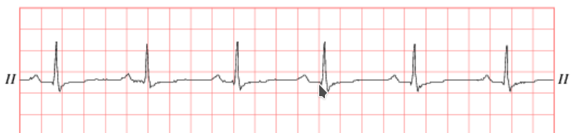
Waveform data
https://physionet.org/physiobank/database/mimic3wdb/
67,830 records
22,317 waveforms matched to MIMIC III clinical database
ECG and other physiologic signals (ABP, respiration, etc)
Stored in proprietary binary format, 217 GB in size for 666 patients

Slide 15
Waveform structure
P01
Encounter
Wave
Segment
Wave
Gap
Wave
Segment
Wave
Gap
Wave
Segment
Wave
Gap
Wave
Segment
P02
Encounter
Wave
Segment
Wave
Gap
Wave
Segment
Wave
Gap
Wave
Segment
P03
Encounter
Wave
Segment
Wave
Gap
Wave
Segment

Slide 16
Waveform preprocessing
Extract waveform data from MIMIC III matched subset for identified PE and non PE patients
Annotate waveform data to identify QRS Complexes
Match waveform data to clinical encounters
Skip bad data
Mark Q, R, and S peaks within each QRS Complex
Output sequences of Q, R, and S peaks and QRS duration per patient

Slide 17
Data extraction
1061 PE patients
735 patients without
waveform data
11 patients without
waveform data
350 non-PE patients
327 waveform
matched PE patients
9 patients with all
segments < 5 min
15 patients with all
segments < 5 min
339 waveform
matched non-PE patients
318 PE patients
96 patients with all
segments outside
PE encounter
115 patients with all
segments outside
PE encounter
324 non-PE patients
222 PE patients
20 patients with
combination of issues
33 patients with
combination of issues
209 non-PE patients
202 PE patients
for machine learning
176 non-PE patients
for machine learning

Slide 18
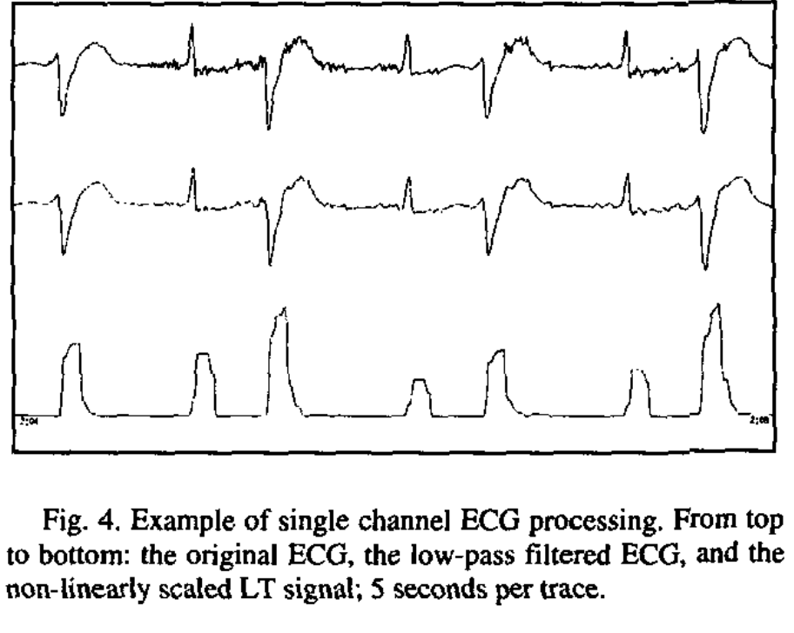
Identification of QRS Complex
Zong W, Moody GB, and Jiang D. A robust open-source algorithm to detect onset and duration of QRS complexes. Computers in Cardiology 30:737-740 (2003).
Toolset exists in wfdb to annotate using this algorithm

Slide 19
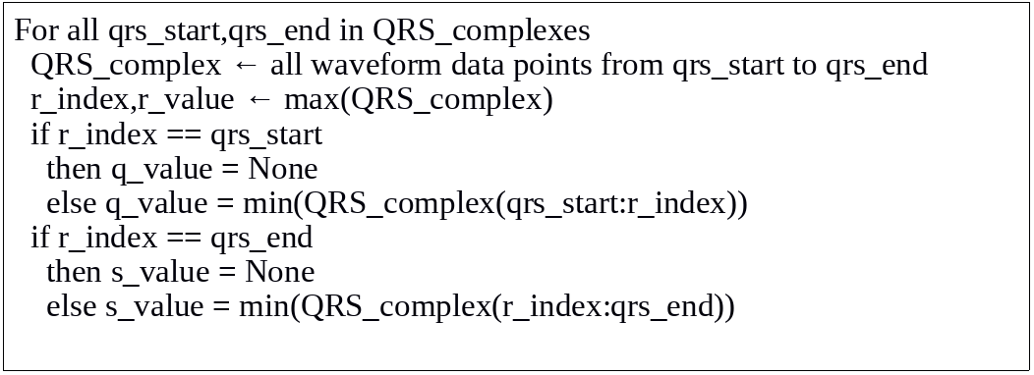
Waveform Annotation to Identify Q, R, S Peaks

Slide 20
Bad data

Slide 21
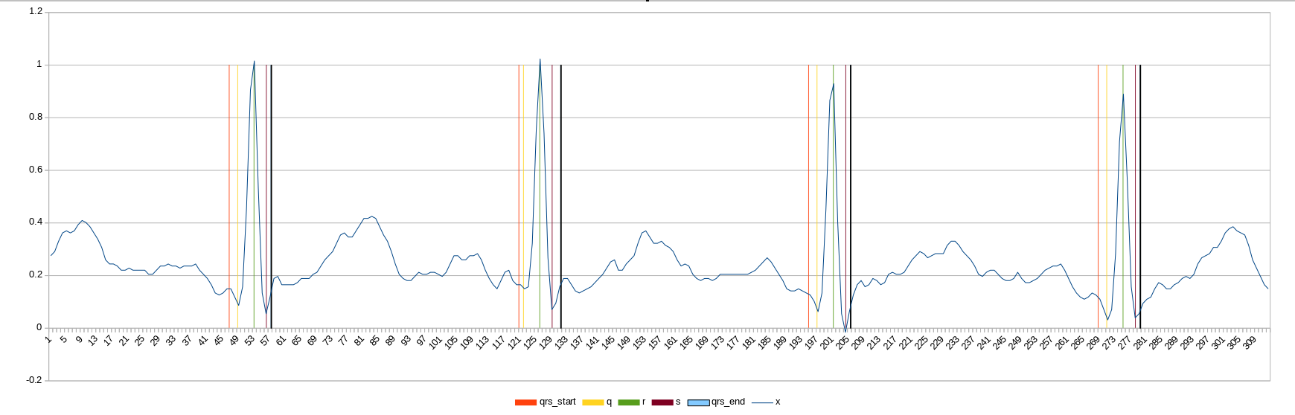
Mark Q, R, and S Peaks

Slide 22
Counter examples

Slide 23
Sample data for LSTM input
Q Peak sequence for a patient
0.46875000,0.32812500,0.49218750,0.35156250,0.60937500,0.35937500,0.47656250,0.33593750,0.53125000,0.53125000,0.36718750,0.48437500,0.55468750,0.33593750,0.54687500,0.32031250,0.45312500,0.34375000...
R Peak sequence for a patient
0.61718750,0.35156250,0.61718750,0.41406250,0.65625000,0.37500000,0.65625000,0.37500000,0.63281250,0.62500000,1.50000000,0.62500000,0.62500000,0.38281250,0.61718750,0.35937500,0.60156250,0.39062500...
S Peak sequence for a patient
0.49218750,0.33593750,0.44531250,0.39062500,0.38281250,0.35937500,0.50781250,0.37500000,0.47656250,0.38281250,0.39062500,0.49218750,0.50000000,0.38281250,0.33593750,0.35156250,0.46093750,0.39062500...
Duration sequence for a patient
120,24,112,56,96,24,96,48,120,104,72,104,88,64,96,32,112,40,96,72,112,112,40,112,112,96,112,112,88,32,64,64,64,48,32,72,40,32,64,64,80,96,72,24,48,48,64,56,64,136,88,112,48,32,40,32,64,40,32,72,32,72...

Slide 24
Long Short Term Memory Networks (LSTM)
A variant of recurrent neural networks (RNN).
The output of the previous time step is fed as the input of the next time step.
The information of previous input can persist in the “internal memory” of the network.
Output layer
Hidden layer
Input layer
time
24
http://colah.github.io/posts/2015-08-Understanding-LSTMs/
Notes:
24

Slide 25
Training Setup
Tool: TensorFlow v1.20
Model: LSTM
Activation function: ReLU
Epochs: 300
Performance measure: accuracy
ReLU = max (0, u)
25

Slide 26
Data
377 sequences for each feature
4 features:
Q peak
R peak
S peak
QRS duration (D)
L
Q
Sequence (time steps)
R
S
D
time
26

Slide 27
Data
N = 358 after data cleaning
Patient 1
 | Training | Testing
PE | 133 | 58
Non-PE | 133 | 34
Total | 266 | 92
Patient 2
…
Patient N
27

Slide 28
Effect of sequence length L
28

Slide 29
1 hidden layer, sequence L = 500
Accuracy = 0.48
29

Slide 30
1 hidden layer, sequence L = 1000
Accuracy = 0.60
30

Slide 31
1 hidden layer, sequence L = 2000
Accuracy = 0.59
31

Slide 32
Effect of hidden layer #
32

Slide 33
1 hidden layer, sequence L = 1000
Accuracy = 0.60
33

Slide 34
2 hidden layers, sequence L = 1000
Accuracy = 0.60
34

Slide 35
3 hidden layers, sequence L = 1000
Accuracy = 0.49
35

Slide 36
Conclusion
Contrast mining discovered some rules of limited clinical significance that may be risk factors for PE development
Neural network failed to produce a viable model to identify PE
1 hidden layer and the first 1000 time steps of the sequences can produce a relatively stable model with accuracy of 0.60 after 300 epochs.
N = 358 may be insufficient for a deep learning task.
36

Slide 37
Future Work
Limitations of LSTM neural network training eliminated large amounts of sequential QRS waveform data due to the issue of sequence length alignment.
Explore other available waveform patterns that are traditionally associated with PE diagnosis.

